Slide 1

Global Underkeel Clearance Management (UKCM) Systems
Michael Kushla
13 March 2018
1

Slide 2
Agenda
Timeline
Definition/Concepts
Static Systems
Prince Rupert, British Columbia (Canada)
Qalhat Terminal (Oman)
Vancouver, British Columbia (Canada)
St. Lawrence River (Canada)
Dynamic Systems
Torres Strait (Australia)
St. Lawrence Seaway (Canada)
Recommendations
Links to UKC Project Team Presentations

Slide 3
Timeline
NIPWG 3 Request from UKCM Project Team for inclusion of
UKCM Systems in S-127 (Traffic Management).
NIPWG 4 Jussland Underkeel Clearance Management System
(based on Torres Strait Underkeel Clearance
Management System) added to Traffic Management
Test Data Set.
NIPWG 4 Action Item 4-14—Request to research other UKCM Systems, including St. Lawrence Seaway Draft
Information System.
NIPWG 5 UKCM Systems paper and presentation.
3

Slide 4
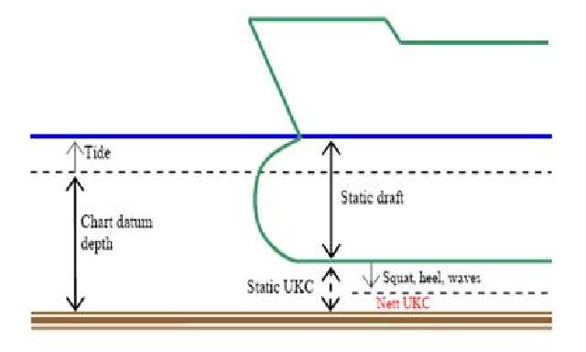
Definition
Underkeel Clearance (UKC)—The distance between the lowest point of the ship's hull, normally some point on the keel, and the sea floor. (IHO Hydrographic Dictionary)

Slide 5
Concepts
Underkeel Clearance Management (UKCM) System—(1) A contemporary Aid to Navigation (AtoN) which enhances navigational safety. (AMSA)
(2) A real-time and nowcast/forecast model system, in conjunction with the vessel response prediction systems, giving the vessel’s master the information needed to effectively manage the vessel’s underkeel clearance. (Adapted from Modern Underkeel Clearance Management published in the International Hydrographic Review, Monaco LXXV(2), September 1998)
Static Systems—Vessels use pre-calculated information to determine their underkeel clearance, with no shore or web-based interactions. (NIPWG)

Slide 6
Concepts (continued)
Dynamic Systems—Vessels monitor their underkeel clearance in real-time using either a web-based system (vessel must pre-register to participate in the system) or a hardware/software-based system (vessel must purchase an approved system loaded with appropriate software to obtain real-time information concerning its underkeel clearance). (NIPWG)

Slide 7
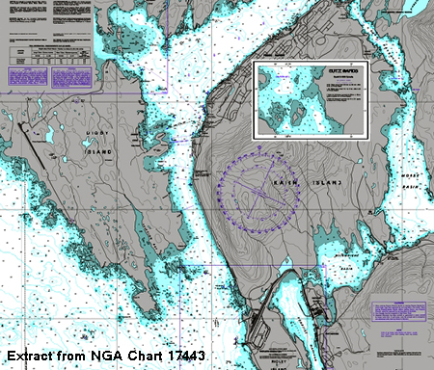
Static Systems
Prince Rupert, British Colombia (Canada)—UKC requirement is a fixed percentage (in this case—10%) of the vessel’s draft.

Slide 8
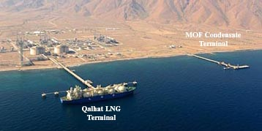
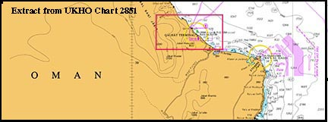
Static Systems (continued)
Qalhat LNG Terminal (Oman)—UKC requirement consisting of a fixed value (in this case—2m at all times).

Slide 9
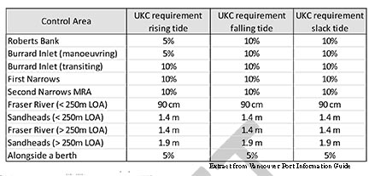
Static Systems (continued)
Vancouver, British Colombia (Canada)—UKC requirements, presented in tabular format, based on vessel location, vessel draft, vessel length overall, and state of the tide (rising, falling, or slack water).

Slide 10
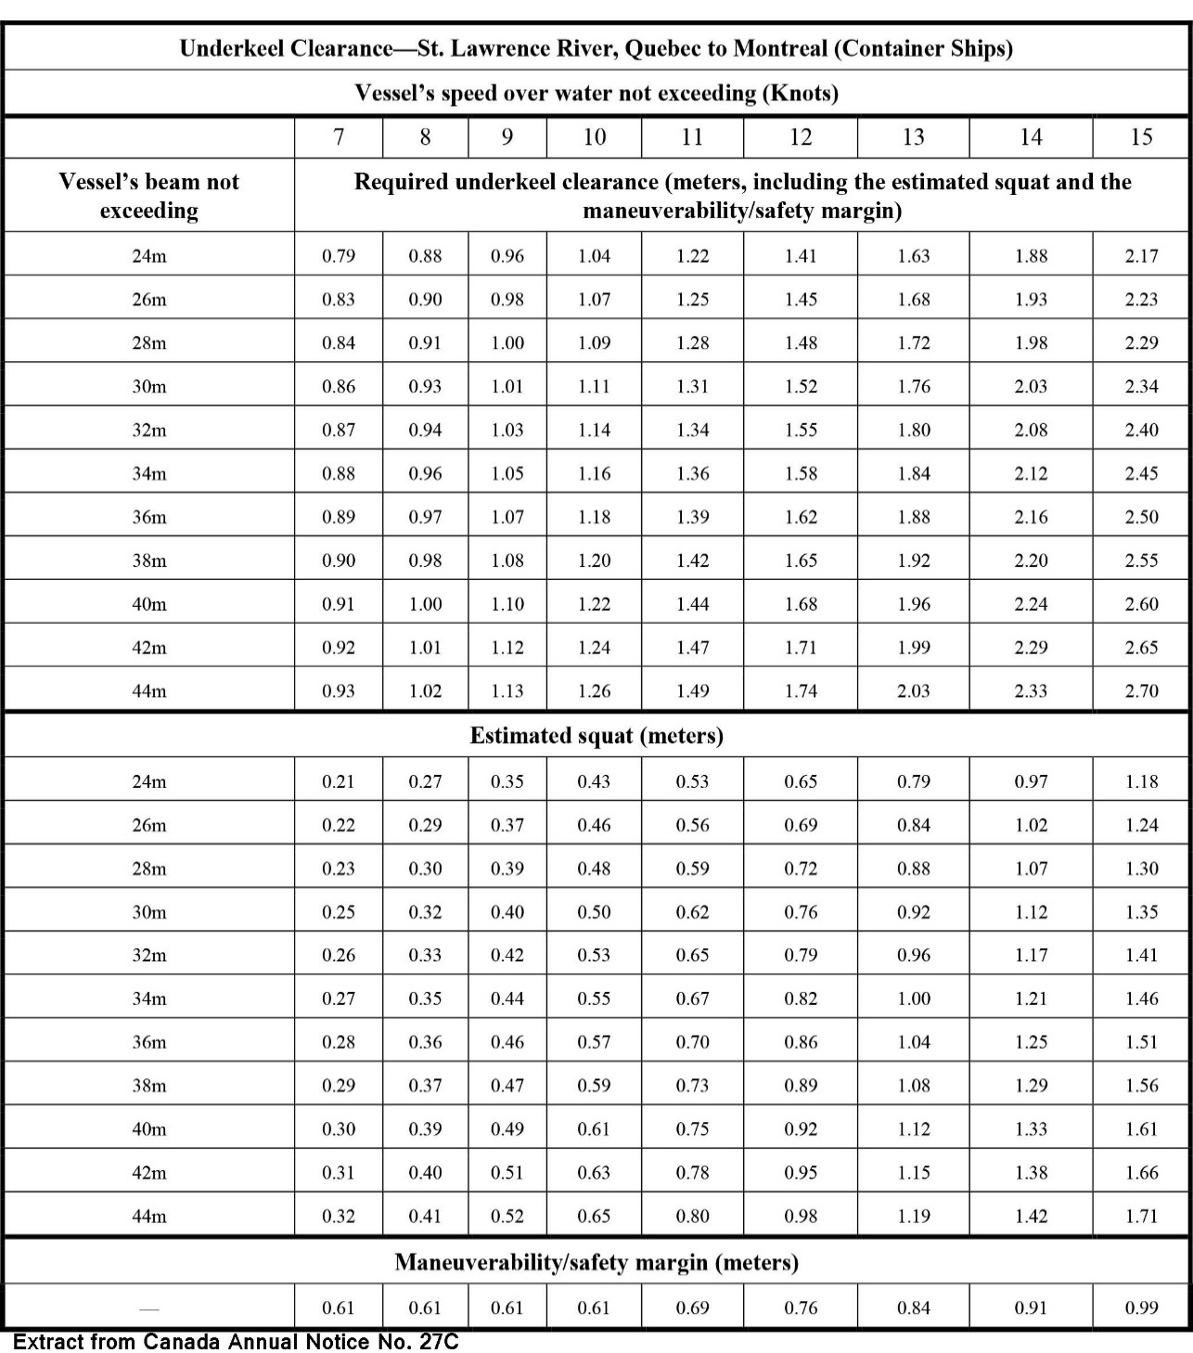
Static Systems (continued)
St. Lawrence River—Quebec to Montreal (Canada)—A complex set of calculations based on vessel type, beam, and speed. These parameters are pre-calculated and disseminated in tabular format. Vessels use this information to determine their underkeel clearance requirements, estimated squat, and safety margin.

Slide 11
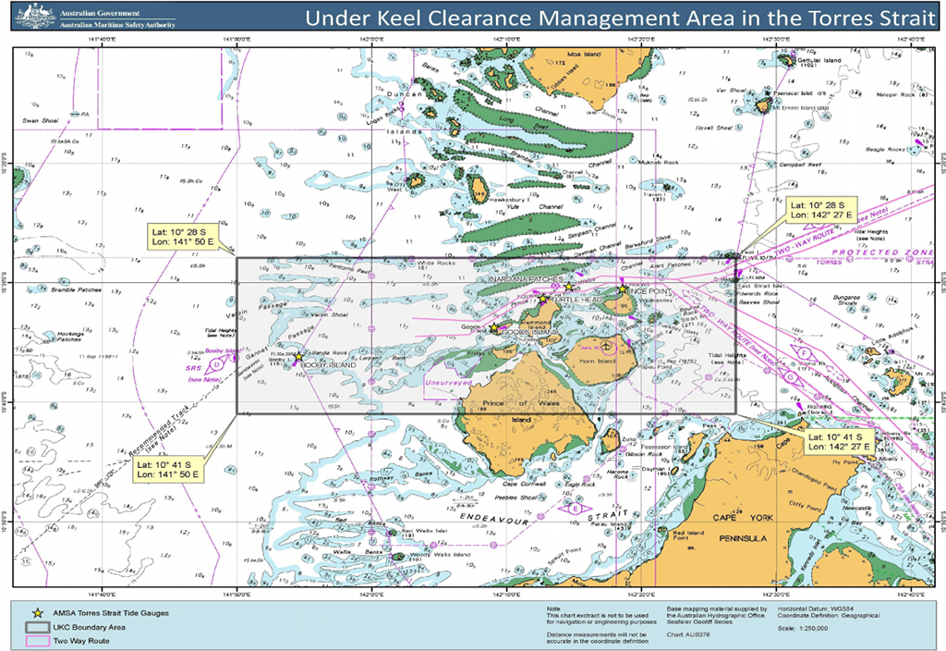
Dynamic Systems
Underkeel Clearance Management System in the Torres Strait (Australia)

Slide 12
Dynamic Systems (continued)
Underkeel Clearance Management System in the Torres Strait (Australia)
Provides real-time underkeel guidance for vessels transiting Prince of Wales Channel, Varzin Passage, and Gannet Passage.
Enhances navigation safety through the Torres Strait, as follows:
Establishing mandatory arrangements for the transits of vessels 8m draft or greater and all oil tankers.
Validating the existing safety margin prescribed by Australian Law (minimum UKC of 1.0m or 10% of draft in Prince of Wales Channel).
Evaluating the appropriateness of the current draft regime (maximum draft of 12.2m).
Provides a mechanism to consider adopting a dynamic UKC regime (i.e. requiring a minimum UKC without a draft restriction).
Vessels must pre-register through the AMSA web site (https://ukcm.amsa.gov.au/security/register) to access the system.

Slide 13
Dynamic Systems (continued)
Underkeel Clearance Management System in the Torres Strait (Australia)
Major components systems of the UKCM System are, as follows:
Vessel Service—Input of vessel parameters and particulars.
Voyage Planning Service—Support long-term planning of transits through the strait, including determining the maximum safe draft for a transit and tidal windows for any 7-day period, up to 1 year in advance.
Transit Planning Service—Support transit planning through the strait, including determining the maximum transit draft, times at key way points (and speed to arrive at the way points on time), and the net underkeel clearance throughout the transit. Provides short-term calculations (< 5 days) of tidal windows for vessel transits.
Transit Monitoring Service—Provide a surface picture and real-time information about all vessels transiting the UKCM Monitoring Area.
Met Ocean Service—Provides “real-time” data received from all UKCM System sensors (tide gauges, a current meter, a weather station, and directional wave-rider buoys) including tide, wave, tidal current, wind, and meteorological information.

Slide 14
Dynamic Systems St. Lawrence Seaway Draft Information System

Slide 15
Dynamic Systems (continued)
St. Lawrence Seaway Draft Information System (DIS) (Canada)
Vessels purchase and install an approved DIS on board.
DIS has been tested and certified to conform to the Implementation Specifications developed by the St. Lawrence Seaway Management Corporation and the St. Lawrence Seaway Development Corporation.
DIS verified to be in compliance by a member of the International Association of Classification Societies (IACS).
Vessel operator performs initial loading of vessel parameters (including the vessel’s deepest draft and the specified underkeel clearance), the required electronic Canadian charts, and any newer editions of Canadian electronic charts.

Slide 16
Dynamic Systems (continued)
St. Lawrence Seaway Draft Information System (DIS) (Canada)
Vessel master certifies personnel training has been completed and the equipment is properly configured and working properly.
Vessel required to submit a DIS operational self-assessment checklist to the Seaway Authority prior to their first transit of the season of the St. Lawrence Seaway and the Welland Canal.
Information on real-time projected underkeel clearance is integrated electronically with chart data, high-resolution bathymetry, and other navigational readings such as water level measurements, vessel speeds, and squat.

Slide 17
Dynamic Systems (continued)
St. Lawrence Seaway Draft Information System (DIS) (Canada)
Real-time water levels and lock gate status are obtained, from water level gauges and coastal AIS stations along the Seaway.
Use of the DIS is optional.
Further information on the DIS, including the DIS Confirmation Checklist, the list of required Canadian electronic charts, and the Implementation Specification can be obtained from the Great Lakes St. Lawrence Seaway System web site: (http://www.greatlakes-seaway.com/en/commercial/transiting/draft_info.html).

Slide 18
Recommendations
Static Systems—Model the static information (vessel parameters, location, underkeel variables, etc.) as given.
Dynamic Systems—Model only that information which gets the vessel to the ”front door” of the system.
Monitor the development of the Product Specification for Underkeel Clearance Management Systems (S-129) by the UKCMPT and adapt their work for possible inclusion in the Product Specification for Traffic Management (S-127).
Monitor the development of the WaterLevel Feature in the Product Specification for Water Level Information for Surface Navigation (S-104) by the TWLCWG.

Slide 19
Presentations Made at UKC Project Team Meetings
AMSA Underkeel Clearance Management
Presentation (Document No. UKCPT2-5)
Presented at UKCPT 2—March 2017
https://www.iho.int/mtg_docs/com_wg/S-100WG/UKCMPT/AMSA%20UKCM%20Presentation%20-%20AMPTC%20Feb%20'17.pptx
UKC Management System at St. Lawrence Seaway (Annex D)
Presented at UKCPT 1—September 2016
https://www.iho.int/mtg_docs/com_wg/S-100WG/UKCMPT/Annex%20D.pdf

Slide 20

UNCLASSIFIED
20
UNCLASSIFIED

